Slide 1

Demo lecture
on
Principal Of Electronic Communication
B.Tech VII Sem
(Introduction of Communication System)
Er.Amit Kumar Tewari
Associate Professor
CSE Department

Slide 2
1. SYLLABUS
Units | Contents of the subject
I | Introduction: Objective, scope and outcome of the course.
II | Introduction: Need for Modulation, Frequency translation, Electromagnetic spectrum, Gain, Attenuation and decibels. Simple description on Modulation: Analog Modulation-AM, Frequency modulation-FM, Pulse Modulation-PAM, PWM, PCM, Digital Modulation Techniques-ASK, FSK, PSK, QPSK modulation and demodulation schemes.
III | Telecommunication Systems: Telephones Telephone system, Paging systems, Internet, Telephony. Networking and Local Area Networks: Network fundamentals, LAN hardware, Ethernet LANs, Token Ring LAN.
IV | Satellite Communication: Satellite Orbits, satellite communication systems, satellite subsystems, Ground Stations Satellite Applications, Global Positioning systems. Optical Communication: Optical Principles, Optical Communication Systems, Fiber –Optic Cables, Optical Transmitters & Receivers, Wavelength Division Multiplexing
V | Cellular and Mobile Communications: Cellular telephone systems, AMPS, GSM, CDMA and WCDMA. Wireless Technologies: Wireless LAN, PANs and Bluetooth, Zig Bee and Mesh Wireless networks, Wimax and MANs, Infrared wireless, RFID communication, UWB.

Slide 3
2. LIST OF BOOKS
Sanjay Sharma – Unit I & II
Anoop Singh Poonia – Unit III
Wiley Publication & Sapna Katiyar – Unit IV Satellite Communication
John M Senior – Unit IV Optical Fiber Communication
1.William Stallings - Unit V Wireless Communication
2.Dr. R. P. Yadav . Lokesh Tharani - Unit V Wireless Communication
3.Rappaport - Unit V Wireless Communication
PEC (Overall) – Louis.E.Frenzel Jr. (Mc Graw Hill)

Slide 4
3. COURSE OUTCOME
S.No. | Description | Blooms’ taxonomy level
CO-7EC6.60.1 -1 | An ability to define the basic concepts of modulation and different types of communication system. | Knowledge L1
CO-7EC6.60.1 -2 | An ability to explain various modulation techniques,telephone system,satellite orbit and systems,fibre optic cables,PAN and Bluetooth | Explain L2
CO-7EC6.60.1 -3 | An ability to interpret the Satellite subsystem and GPS, Paging, types of LAN,optical Tx and Rx system. | Explain L2
CO-7EC6.60.1 -4 | An ability to make use of LAN H/W,satellite applications & GPS,wireless and Cellular Technologies. | Examine L3
CO-7EC6.60.1 -5 | An ability to catagorize different modulation and communication techniques. | Catagorize L4

Slide 5
4: Topics To be Covered
Introduction
Communication Process
Elements of a Communication System
Concept of bandwidth
Source of information
Communication Channel
Baseband and Pass band Signals
Modulation Process
Types of Modulation
Need for Modulation
Topics to be covered next
Glossary (Important Terms)

Slide 6
5: Objectives
After Completion of this Lecture ,you will be able to :-
Explain the functions of three main parts of an electronic communication system.
Discuss the role of Modulation & need for it in Signal Transmission.
Explain the elements of communication system and communication channel.
List the major branches of the field of electronic communication and different job roles offered in the industry.
State the benefit of licensing and certification.

Slide 7
5.1: Scope
Can find a job in Consumer electronics manufacturing organization , Telecommunication & IT industries, Health care equipment manufacturing , Mobile communication (4G,5G,6G), Internet technologies, Power Electronics, and other industries like steel, petroleum and chemical industry, directing control and testing production process.
Technical sales, product representation, systems management, the design and manufacture of electronic devices and systems, or the installation, maintenance and repair of electronic systems and equipment.

Slide 8
5-2: Scope
They may also work with computers and electronic equipment in the medical, manufacturing, industrial control, telecommunications, aeronautical and military fields.
Are acquired by top recruiters like DMRC, Siemens, Motorola, Intel, Texas Instruments, BEL, ISRO, DRDO, Accenture, Wipro, HCL Technologies, NVidia, Samsung, Tech Mahindra, Infosys, TCS, Conexant, MTNL, AIR, BSNL, Indian Air force, Indian Navy, Railways, Bharat Electronics Ltd and Flextronics and Philips Electronics.

Slide 9
6: JOB ROLES
FOR ENGINEERS
DESIGNING
MANUFACTURING
TESTING
QUALITY CONTROL
INSTALLATION SUPPORT
TROUBLESHOOTING
TECHNICAL SALE
TECHNICAL WRITER
TRAINER

Slide 10
7: LICENSING & CERTIFICATION
A good way to validate your knowledge of communication electronics is to
obtain a relevant license or certification.
Listed below are some of the licenses and certifications available for communication
electronics.
FCC (federal Communication Commission) General radiotelephone Operators License (GROL)
International Society of Certified Electronic Technicians (ISCET)
The International Association for Radio, Telecommunications and Electromagnetic (iNARTE)
Cisco – This company is major supplier of networking and wireless equipment and offers certifications in many networking-related areas.eg.Cisco Certified Network Associate (CCNA).
Cisco Certification is widely recognized throughout the industry.

Slide 11
Introduction
Electronic Communication is the process of establishing connection or link between two points (Source & Destination) for information exchange.
Thus Communication is the process of
Transmission
Reception
Processing
Earlier long Distance Communication includes: smoke signals, light beams, carrier Pigeons etc.

Slide 12
Cont..
The original information source can be in Analog (continuous) form, such as the human voce or in the Digital (Discrete) Form, such as binary coded numbers.

Slide 13
Elements of Communication System
Information Source :- (Analog & Digital) – Message and information originates in the information source. (words,code,symbols,sounds,signals etc.) In short the function of the information source is to provide required message which has to be transmitted.
Input Transducer :- use to convert one form of energy to another.For eg. In case of radio broadcasting a microphone converts the information of message in the electrical signal.
Transmitter :- The function of the transmitter is to process the electrical signal from different Aspects.Modulation is the main function of the transmitter. (Message signal is superimposed upon the high frequency carrier signal)
Channel and Noise :- Channels means medium through which the message travels from transmitter to reciever.

Slide 14
Elements of Communication System
There are two types of channels :-
Point to Point (Eg. Wireless,Microwave links,optical Fiber)
Broad Cast Channel (Eg. Satellite in Geostationary orbit)
During the process of Tx and Rx the signal get distorted due to the Noise introduced in the system.
Noise is the unwanted signal which tends to Interfere with the Required Signal.
Receiver :- The main function of the Rx is to reproduce the message signal in the original form from the distorted received Signal.
This is called de-modulation or detection.
Destination :- This is the final stage which is used to convert an electrical message signal in to its original form.

Slide 15
Concept Of Bandwidth
It may be defined as the Portion of the Electromagnetic* Spectrum occupied by a signal or we may also define the bandwidth as the frequency range over which an information signal is transmitted.
Each of these signals will have its own frequency range.
This frequency range of a signal is known as its Bandwidth.
For Eg. The range of music signal is 20 Hz to 15 KHz
The Bandwidth will be (f2 – f1)
Thus, BW = 15000 – 20
= 14980 Hz.
*The entire range of frequencies of EM waves is called as electromagnetic spectrum. The frequencies of electromagnetic wave can be very low or it can be extremely high.

Slide 16
Sources of Information
Some of the Important Sources of information in the communication environment may be listed as under :
Speech
Music
Pictures
Computer Data
A source of information is basically a signal which carries the information.

Slide 17
Communication Channels
The Medium over Which the information is passed from the Tx to Rx is called as a communication channel. Depending on the mode of Transmission , we may classify the channels in to following categories.
(i) Channels based on guided propagation.
Telephone channels
Coaxial Cable
Optical Fiber
(ii) Channels based on free propagation.
Wireless broadcast channels
Satellite channels
Mobile radio channels

Slide 18
Baseband and Pass band Signals
The message signal generated from the information source is known as baseband signal. It may be a combination of two or more message signal.
If the baseband signal is transmitted directly then it is known as baseband transmission. This means that the baseband transmission does not used modulators and demodulators.
This type of transmission is preferred at low frequency and for short distances.
Now if the modulated signal is transmitted over the channel,it is known as bandpass or passband transmission.

Slide 19
Modulation Process
The purpose of a communication system is to deliver a message signal from an information source in recognizable form to a user destination, with the source and the user being separated from each other.
For this the transmitter modifies the message signal into a form which is suitable for transmission over channel, this is known as Modulation.
“ Modulation may be defined as the process by which some characteristics of a signal called carrier is varied in accordance with the instantaneous value of another signal called modulating signal (signal containing information)”

Slide 20
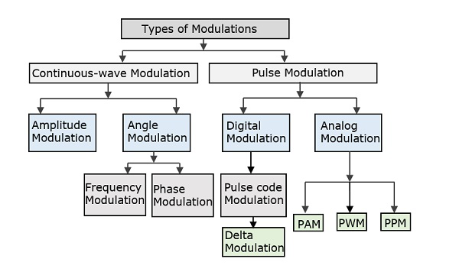
2-6: Type of Modulation
There are many types of modulations. Depending upon the modulation techniques used, they are classified as shown in the following figure.

Slide 21
Cont…
Continuous Wave Modulation :- When the carrier wave is continuous in nature, the modulation process is known as continuous wave modulation (CWM) or analog modulation.
Examples of the CWM are Amplitude Modulation and Angle Modulation.
When the amplitude of the carrier is varied in accordance with the message signal, it is known as Amplitude Modulation (AM).
When the angle of the carrier is varied according to the instantaneous value of the modulating signal, it is called angle modulation .
Angle Modulation may be further subdivided into frequency Modulation (FM) and Phase Modulation (PM) , in which the instantaneous frequency and phase of the carrier, respectively are varied in accordance with the message signal.

Slide 22
Cont…
Pulse Modulation :- When the carrier wave is pulse-type waveform, the modulation process is known as pulse modulation. In Pulse modulation, a periodic sequence of rectangular pulses, is used as a carrier wave.
It may be of analog or digital type.
The Analog Pulse Modulation may be of the Following three type:
(a) Pulse-amplitude modulation (PAM)
(b) Pulse-duration Modulation (PDM)
(c) Pulse-position Modulation (PPM)
On the other hand the digital form of the pulse modulation is Known as pulse-code modulation (PCM) & Delta Modulation (DM)

Slide 23
Need for Modulation
The baseband signals are incompatible for direct transmission.
For such a signal, to travel longer distances, its strength has to be increased by modulating with a high frequency carrier wave, which doesn’t affect the parameters of the modulating signal.
The antenna used for transmission, had to be very large, if modulation was not introduced. The range of communication gets limited as the wave cannot travel to a distance without getting distorted.
Following are some of the advantages for implementing modulation in the communication systems:
Antenna size gets reduced, No signal mixing occurs.
Communication range increases, Multiplexing of signals occur, Adjustments in the bandwidth is allowed.
Reception quality improves

Slide 24
Need for Modulation
Practicality of Antenna:
When Free space is used as a transmitting medium ,messages are transmitted and received with the help of antennas. For efficient radiation and reception the transmitting and receiving antennas must have lengths comparable to a quarter-wavelength of the frequency used.
For Eg.:- In AM Broad cast system, the maximum AF transmitted from a radio station is of 5 KHz. If this message audio signal were to be transmitted without modulation, then the height of the antenna required for an effective radiation and reception will be 1/4th of the wavelength given as

Slide 25
Need for Modulation
l = λ/4
or
l = c/4f
or
l = 3 x 10⁸ / 4 x 5 x 10³
or
l = 5 Km.
As you see it will be totally impracticable to construct and install an antenna of such a height .
However this height of the Antenna may be reduced by modulation technique and effective radiation & reception may be achieved.

Slide 26
Topics To be Covered in Next Class
Analog and Digital Communication Signal
Analog and Digital Communication System
Advantages and Disadvantages of Digital Communication
Performance Comparison of Analog and Digital Communication
Frequency and wavelength
EM Spectrum
Fundamental Limitations of communication system

Slide 27
Glossary of the Lecture
Baseband
Pass band
Carrier
Channel
Distortion
Modulation
Demodulation or Detector
Bandwidth
EM Spectrum

Slide 28
END
THANK YOU

Slide 29
2-7: Frequency Translation
The frequency translation can be defined as; it is one kind of method for transmitting a signal from one fraction of the frequency axis to another fraction of the axis.
This is frequently done within the wireless communications system to transmit a passband signal toward baseband previous to demodulation.
Compound multipliers are used for performing frequency conversion; however, a more efficient technique is to employ decimation.

Slide 30
2-8: Electromagnetic Spectrum
The electromagnetic spectrum is the entire range of electromagnetic radiation according to the wavelength or frequencies.
It has a range of frequencies from 1Hz to Hz.
The waves in order of increasing frequencies are radio waves, microwaves, infrared rays, visible light, UV rays, X-rays and gamma rays.
Among these range, the frequencies between Hz to Hz are used for communication.

Slide 31
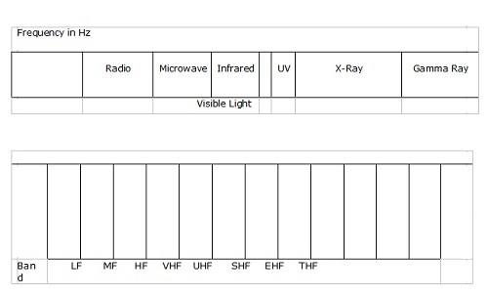
2-8: Electromagnetic Spectrum
The following diagram shows the electromagnetic spectrum. The first figure gives the full range of frequency spectrum while the second figure elaborates that part of the spectrum which can be used for data communication −

Slide 32
2-8: Electromagnetic Spectrum
The section of the spectrum in the range of radio waves and microwaves has been divided into a number of frequency bands as officially referred by ITU (International Telecommunication Union).
These bands are rated from VLF (Very Low Frequency) to EHF (Extremely High Frequency).
The frequency bands and their uses in communication is tabulated as follows −

Slide 33
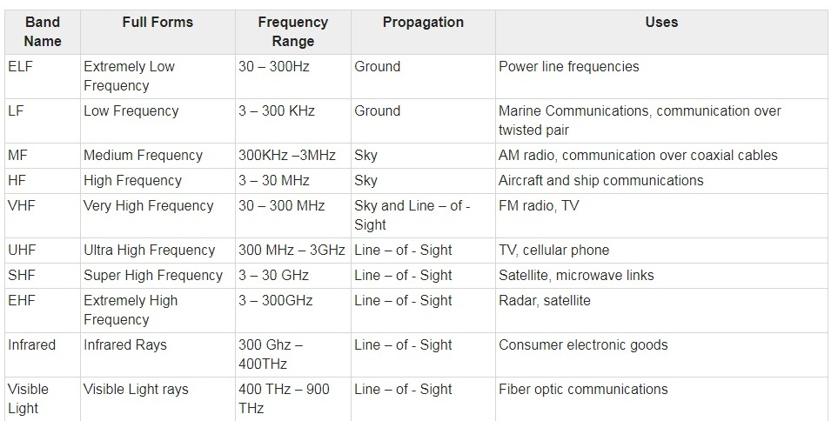
2-8: Electromagnetic Spectrum

Slide 34
2-8: Electromagnetic Spectrum
The section of the spectrum in the range of radio waves and microwaves has been divided into a number of frequency bands as officially referred by ITU (International Telecommunication Union).
These bands are rated from VLF (Very Low Frequency) to EHF (Extremely High Frequency).
The frequency bands and their uses in communication is tabulated as follows −

Slide 35
2-9: Gain, Attenuation, and Decibels
Most circuits in electronic communication are used to manipulate signals to produce a desired result.
All signal processing circuits involve:
  Gain
  Attenuation

Slide 36
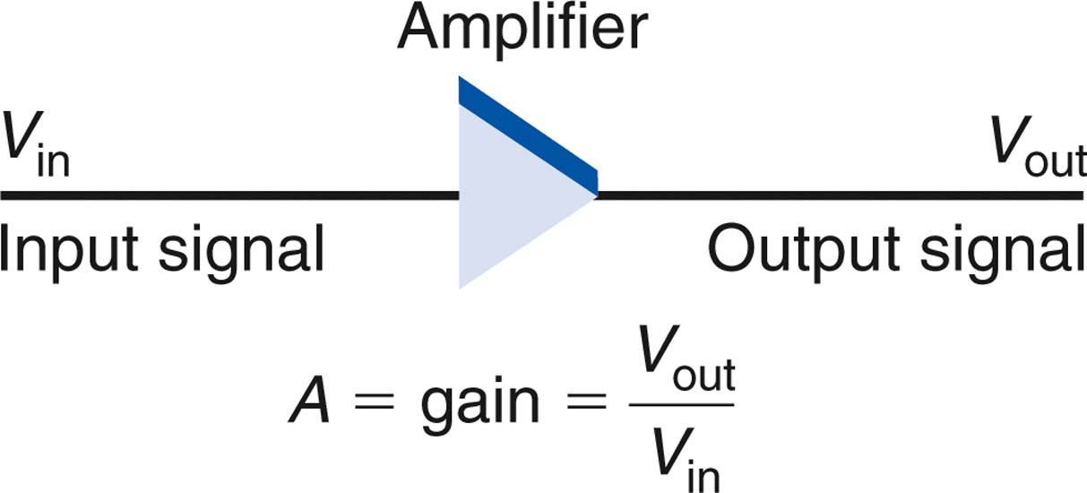
2-9: Gain, Attenuation, and Decibels
Gain
  Gain means amplification. It is the ratio of a circuit’s output to its input.
output
V_{out}
A_{V} =
=
input
V_{in}
Figure 2-1: An amplifier has gain.

Slide 37
2-9: Gain, Attenuation, and Decibels
An amplifier is cascaded when two or more stages are connected together.
The overall gain is the product of the individual circuit gains.
Example:
Three cascaded amplifiers have power gains of 5, 2, and 17. The input power is 40 mW. What is the output power?
A_{p} = A₁ × A₂ × A₃ = 5 × 2 × 17 = 170
A_{p} = P_{out} / P_{in} therefore P_{out} = A_{p}P_{in}
P_{out} = 170 (40 × 10⁻³) = 6.8W

Slide 38
2-9: Gain, Attenuation, and Decibels
Attenuation
  Attenuation refers to a loss introduced by a circuit or component. If the output signal is lower in amplitude than the input, the circuit has loss or attenuation.
  The letter A is used to represent attenuation
  Attenuation A = output/input = V_{out}/V_{in}
  Circuits that introduce attenuation have a gain that is less than 1.
  With cascaded circuits, the total attenuation is the product of the individual attenuations.

Slide 39
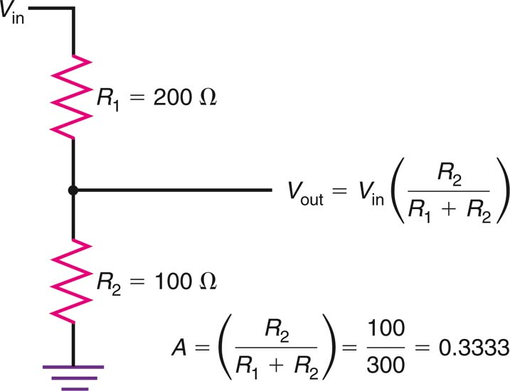
2-9: Gain, Attenuation, and Decibels
Figure 2-3: A voltage divider introduces attenuation.

Slide 40
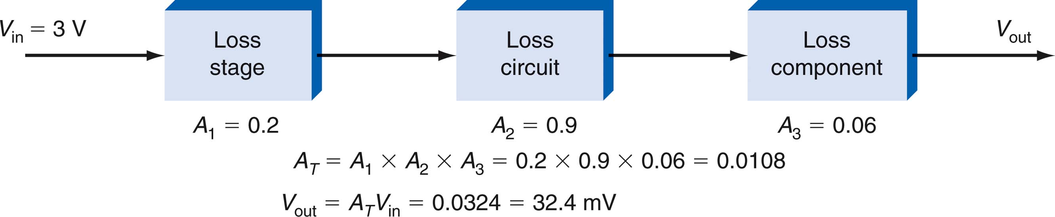
2-9: Gain, Attenuation, and Decibels
Figure 2-4: Total attenuation is the product of individual attenuations of each cascaded circuit.

Slide 41
2-9: Gain, Attenuation, and Decibels
Decibels
  The decibel (dB) is a unit of measure used to express the gain or loss of a circuit.
    The decibel was originally created to express hearing response.
    A decibel is one-tenth of a bel.
  When gain and attenuation are both converted into decibels, the overall gain or attenuation of a circuit can be computed by adding individual gains or attenuations, expressed in decibels.

Slide 42
2-9: Gain, Attenuation, and Decibels
Decibels: Decibel Calculations
  Voltage Gain or Attenuation
  dB = 20 log V_{out}/ V_{in}
  Current Gain or Attenuation
  dB = 20 log I_{out}/ I_{in}
  Power Gain or Attenuation
  dB = 10 log P_{out}/ P_{in}

Slide 43
2-9: Gain, Attenuation, and Decibels
Decibels: Decibel Calculations
Example:
  An amplifier has an input of 3 mV and an output of 5 V. What is the gain in decibels?
    dB = 20 log 5/0.003
    = 20 log 1666.67
    = 20 (3.22)
    = 64.4

Slide 44
2-9: Gain, Attenuation, and Decibels
Decibels: Decibel Calculations
Example:
  A filter has a power input of 50 mW and an output of 2 mW. What is the gain or attenuation?
    dB = 10 log (2/50)
    = 10 log (0.04)
    = 10 (−1.398)
    = −13.98
  If the decibel figure is positive, that denotes a gain.

Slide 45
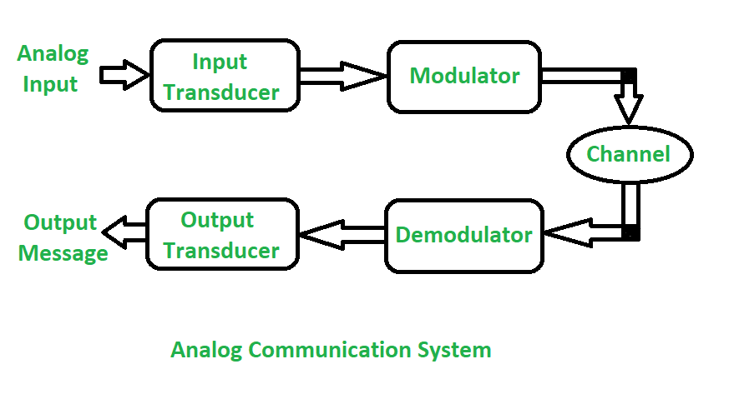
ANALOG AND DIGITAL COMMUNICATION
Analog Communication:
In analog communication the data is transferred with the help of analog signal in between transmitter and receiver. Any type of data is transferred in analog signal. Any data is converted into electric form first and after that it is passed through communication channel. Analog communication uses a continuous signal which varies in amplitude, phase, or some other property with time in proportion to that of a variable.

Slide 46
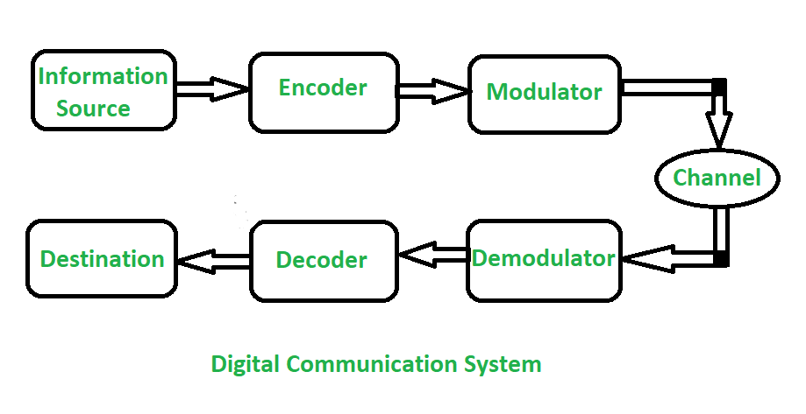
ANALOG AND DIGITAL COMMUNICATION
2. Digital Communication:
In digital communication digital signal is used rather than analog signal for communication in between the source and destination. The digital signal consists of discrete values rather than continuous values. In digital communication physical transfer of data occurs in the form of digital bit stream i.e 0 or 1 over a point-to-point or point-to-multipoint transmission medium . In digital communication the digital transmission data can be broken into packets as discrete messages which is not allowed in analog communication.

Slide 47
ANALOG AND DIGITAL COMMUNICATION
Difference between Analog Communication and Digital Communication:
ANALOG COMMUNICATION | DIGITAL COMMUNICATION
In analog communication analog signal is used for information transmission. | In digital communication digital signal is used for information transmission.
Analog communication uses analog signal whose amplitude varies continuously with time from 0 to 100. | Digital communication uses digital signal whose amplitude is of two levels either Low i.e., 0 or either High i.e., 1.
It gets affected by noise highly during transmission through communication channel. | It gets affected by noise less during transmission through communication channel.
In analog communication only limited number of channels can be broadcasted simultaneously. | It can broadcast large number of channels simultaneously.
In analog communication error Probability is high. | In digital communication error Probability is low.

Slide 48
ANALOG AND DIGITAL COMMUNICATION
Difference between Analog Communication and Digital Communication:
ANALOG COMMUNICATION | DIGITAL COMMUNICATION
In analog communication noise immunity is poor. | In digital communication noise immunity is good.
In analog communication coding is not possible. | In digital communication coding is possible. Different coding techniques can be used to detect and correct errors.
Separating out noise and signal in analog communication is not possible. | Separating out noise and signal in digital communication is possible.
In analog communication for multiplexing Frequency Division Multiplexing (FDM) is used. | In Digital communication for multiplexing Time Division Multiplexing (TDM) is used.
Analog communication system is low cost. | Digital communication system is high cost.

